Slide 1
Sandbox PoC
www.velankani.com
NOV 2014

Slide 2
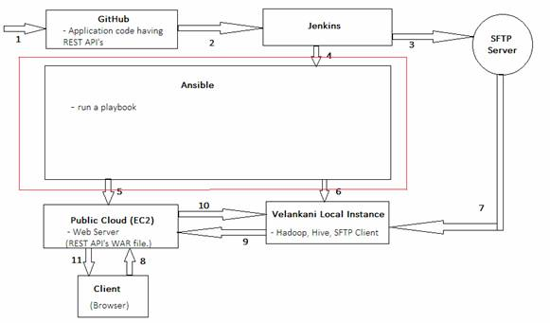
Sandbox Work flow Overview

Slide 3
Sandbox Work flow Overview
Committing the code in Git Hub Repository.
Jenkins will fetch the code from Git Hub repository and create a WAR file out of it.
Jenkins will push the WAR to the SFTP-server.
Jenkins will Trigger aN ansible playbook
Ansible will provision Apache Hadoop, SFTP-client and Test Application on the Velankani local instance.
Ansible will start the SFTP-client, which fetch CDR-Files from SFTP-server
Velankani local instance will pass the data to EC-2 Instance through Rest API’s.
Output is shown in the browser in the form of bar charts.

Slide 4
Sandbox Test Setup
Ubuntu Machine2:
10.0.12.57:4440
Ubuntu Machine 1
10.0.12.48:8080
AWS VM Console
Rundeck Console (jobs)
GitHub (Repository)
Ubuntu VM (10.0.12.48:8080)
Jenkins (trigger Rundeck job)
Ubuntu Machine3:
10.0.12.100:8080
Ubuntu VM Rundeck/Ansible Sever/SFTP server Running
Cookbook/……
Upload_Files/…
CDR Generation Script
)
Chef Client
Chef Client
Chef Client
Chef Client
Tomcat Server
Tomcat Server
Tomcat Server
Tomcat Server
HTTP/HTTPS
War File Deployed
War File Deployed
War File Deployed
War File Deployed
AWS VM (ubuntu)
Ubuntu Machine 4
10.0.12.54
54.187.109.152
AWS VM (ubuntu)
SFTP/HTTP
Ubuntu VM
Hadoop(hdfs)
Hive
SFTP Client
Trest Application
Scripts
Backup_files/
)
HTTP/HTTPS
NOV 2014

Slide 5
Steps for Creating Sandbox setup
VM1: (Jenkins Server & GitHub server - 10.0.12.48:8080 )
Configurations details:
    Ubuntu (X86_64)
    1 GB RAM
    20 GB HDD
  Jenkins server and GitHub plugins need to be installed.
  Git hub repository is configured with Jenkin.
  Job created in jenkin which triggers the ansible playbook

Slide 6
Jenkins Installation & Configuration:
Important steps and pre-requisites:
Java 8 need to be installed
A GitHub account
Install Jenkins (http://tecadmin.net/install-jenkins-in-ubuntu/ )
Configure SSH to create a secure connection between Jenkins System and GitHub (https://help.github.com/articles/generating-an-ssh-key/ )

Slide 7
ANSIBLE AND AWS INTEGRATION
SOFTWARES USED:
ANSIBLE & AWS
Overview of Ansible:
The aim was to provision an AWS instance in AWS Cloud and to Install Tomcat server in it.
Later Rundeck/Jenkins will use that VM to give out the results to the client.

Slide 8
Cont..
VM4: (Ansible Server - 10.0.12.100:8080 )
Configurations details:
    Ubuntu (X86_64)
    4 GB RAM
    10 GB HDD
Important Pre-requisites:
Ansible (Latest Version)
Open-ssh Server
Boto plug-in for AWS
An AWS account
SSH configuration (private and public key pairs)
Provision an EC2 Instance in cloud using ansible
Install Tomcat Server on the cloud Instance.

Slide 9
Cont..
Accomplishments:
Completed provisioning an instance in the AWS cloud.
Challenges:
The part where we stuck is to access the created instance and install the tomcat server.

Slide 10
HADOOP INSTALLATION
Requirements:
    Ubuntu 10.04LTS (ansible controller node)
    Ubuntu 10.04LTS (ansible host node for hadoop installation)
Playbook
Ansible host node
Ansible controller node
Ubuntu 14.04 LTS
10.0.12.55 IP
Ubuntu 14.04 LTS
10.0.12.54 IP

Slide 11
Pre-requisites for hadoop installation
Requirements for VM (Ansible controller node :10.0.12.55)
    Ansible 2.2
    SSH connection to VM2 (/etc/ansible/hosts)
Requirements for VM (Ansible host node 10.0.12.54)
    Java Version 1.7
    Hadoop Version 2.4
    SSH

Slide 12
Accomplishments
Playbooks are written for each step of hadoop installation in controller node 10.0.12.55
  Installation of Java
  Creating Hadoop group and adding hduser
  SSH configuration
  Installation of Hadoop
  Setup configuration files(bashrc,hadoop-env.sh,core-site.xml,mapred-site.xml.template,hdfs-site.xml)
Sucessfully executed playbooks for hadoop group creation,adding hduser,ssh configuration, installation of hadoop and configuration setup files on 10.0.12.54

Slide 13
Challenges
Installation of java(full ip access)
Command execution like hadoop namenode format and start-all.sh

Slide 14
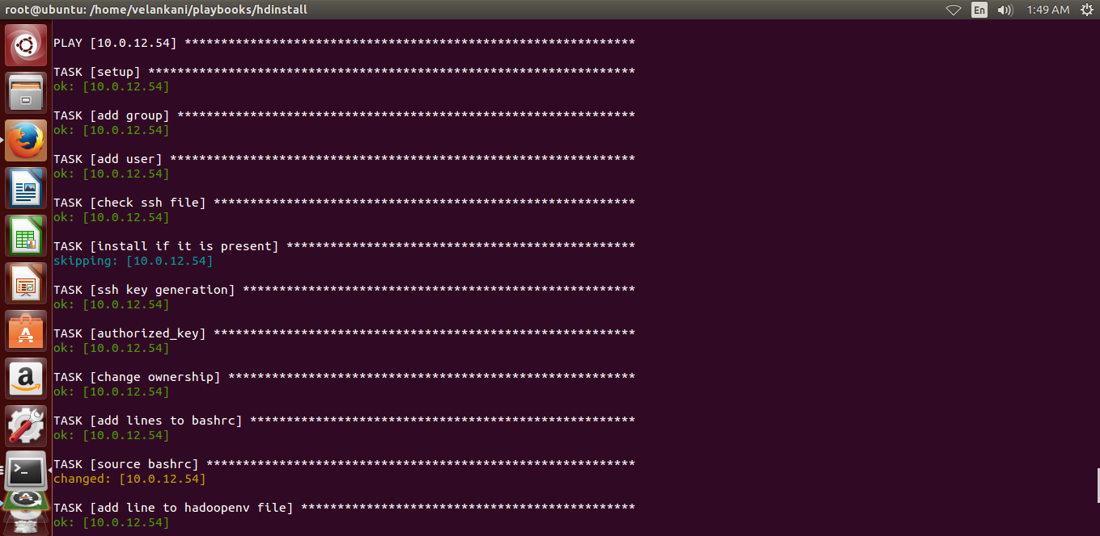
Execution of playbook
Cmd:ansible-playbook hdinstall.yml

Slide 15
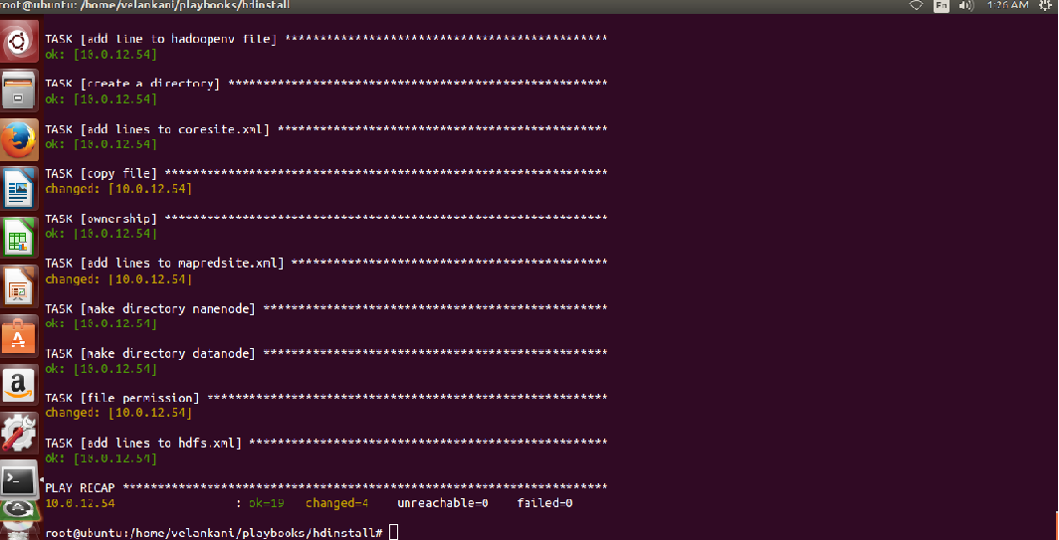

Slide 16
Sandbox Demo Screenshots
Committing the code in Github
Jenkins Start-Up
Jenkins triggering RunDeck Job
Installation Logs for Hadoop
SFTP-client Installation
Instance In AWS
Tomcat Installation

Slide 17
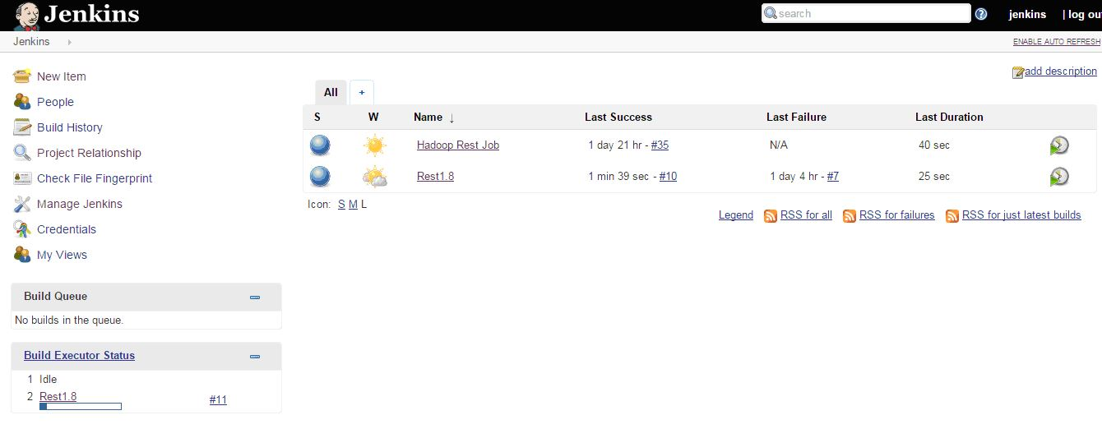
Jenkins Start-Up

Slide 18
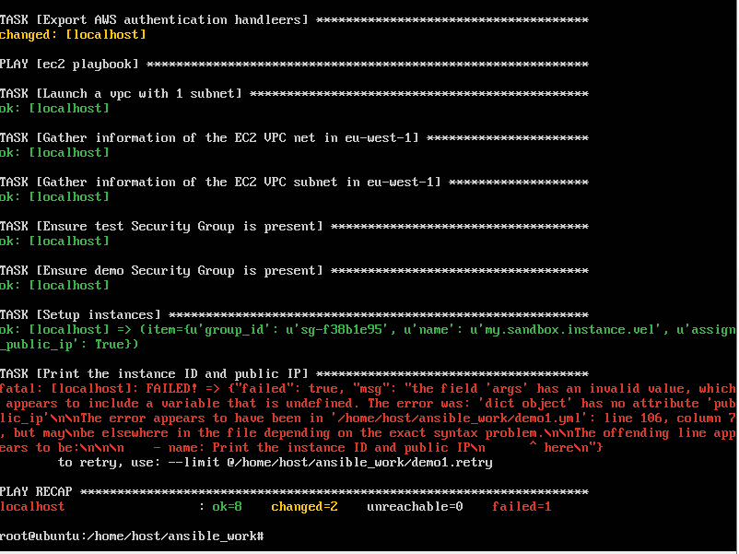
Creating an Instance on AWS

Slide 19
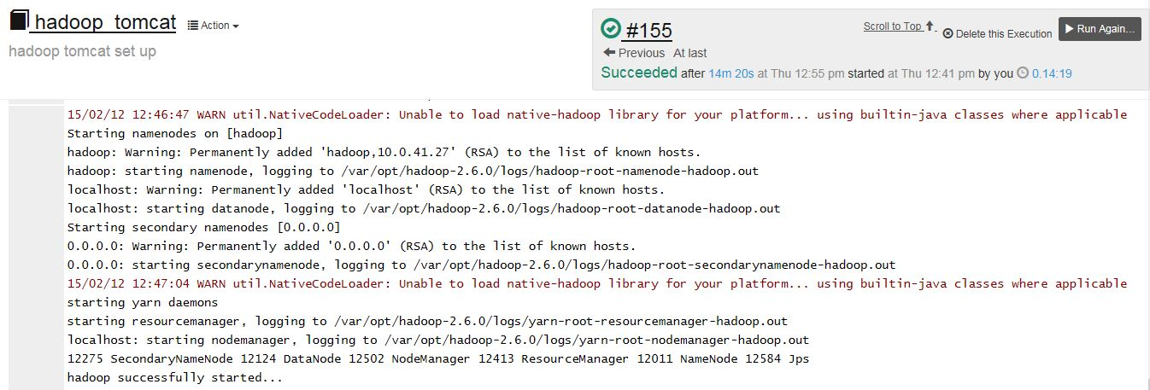
Installation Of Hadoop

Slide 20
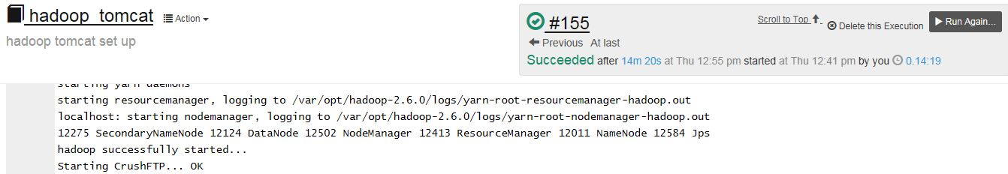
SFTP-Client Installation

Slide 21
Thank You
www.velankani.com
NOV 2014

